Slide 1
Crime Regulation as a Means to Control Crime: Opportunity Reduction
Michael Townsley and Ben Hutchins

Slide 2
…Offenders who commit robbery, burglary or vehicle crime as their debut offence were at the greatest risk of becoming chronic offenders.

Slide 3
Research Questions
Trends in number of debut offenders
(a) What are the most common debut offences; and
(b) Which debut crimes have higher risks of becoming a prolific offender
3. Is there evidence supporting the debut hypothesis in Qld?

Slide 4
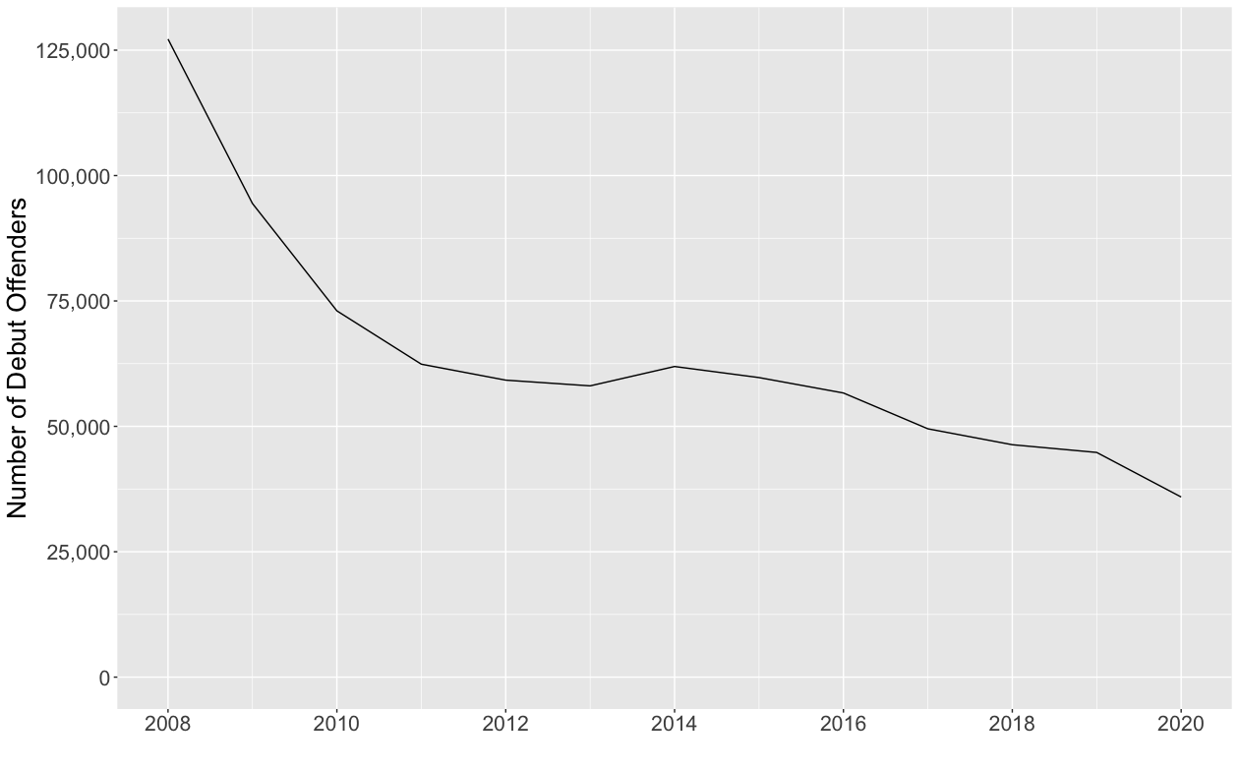
RQ 1 Number of debut offenders over time

Slide 5
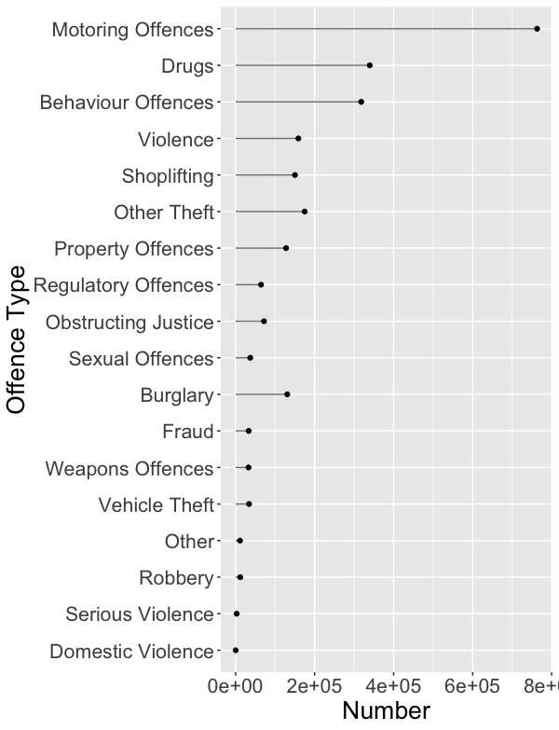
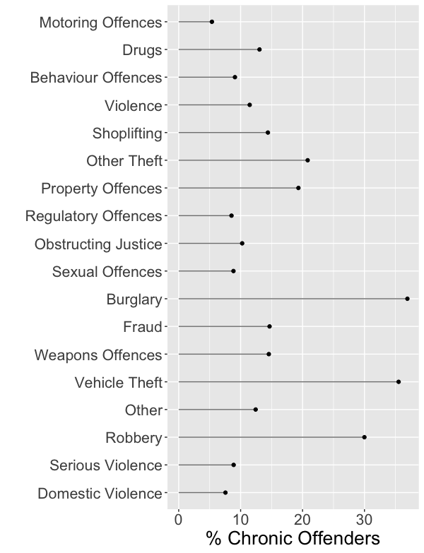
RQ 2 debut offence frequency and % chronic

Slide 6
RQ 3 Evidence for debut crime hypothesis

Slide 7
Farrell G, et al. The Crime Drop and the Security Hypothesis. Journal of Research in Crime and Delinquency. 2011;48(2):147-175. doi:10.1177/0022427810391539

Slide 8
debut crime hypothesis:
(a) security improvements make debut crimes more difficult, more risky or less rewarding.
(b) fewer debut crimes = fewer young people with criminal careers
(c) fewer criminal careers = reduction in a wide range of offences, including acquisitive and violent ones.

Slide 9
THANK YOU

